Slide 1

AWS Web Services Natural Language Processing

Slide 2
Agenda
NLP Introduction
NLP Evolution
AWS NLP Approach
AWS NLP Services
Discussion
AI Services Demo

Slide 3





















The AWS ML Stack Broadest and most complete set of machine learning capabilities
AI SERVICES
HEALTH AI
INDUSTRIAL AI
ANOMALY DETECTION
CODE AND DEVOPS
NEW
Amazon HealthLake
Amazon Transcribe Medical
Amazon Comprehend Medical
NEW
AWS Panorama + Appliance
NEW
Amazon Monitron
NEW
Amazon Lookout for Equipment
NEW
Amazon Lookout for Vision
NEW
Amazon Lookout for Metrics
NEW
Amazon DevOps Guru
Amazon CodeGuru
 | VISION | SPEECH | TEXT | SEARCH | CHATBOTS | PERSONALIZATION | FORECASTING | FRAUD | CONTACT CENTERS
Amazon Rekognition
Amazon Polly
Amazon Transcribe
+Medical
Amazon Comprehend
+Medical
Amazon Translate
Amazon Textract
Amazon Kendra
Amazon Lex
Amazon Personalize
Amazon Forecast
Contact Lens
Amazon Fraud Detector
Voice ID
For Amazon Connect
ML SERVICES
SAGEMAKER STUDIO IDE
Label data | NEW Aggregate & prepare data | NEW Store & share features | Auto ML | Spark/R | NEW Detect bias | Visualize in notebooks | Pick algorithm | Train models | Tune parameters | NEW Debug & profile | Deploy in production | Manage & monitor | NEW CI/CD | Human review
Amazon SageMaker
NEW: SageMaker JumpStart
NEW: Model management for edge devices
FRAMEWORKS & INFRASTRUCTURE
Deep Learning AMIs & Containers | GPUs & CPUs | Elastic Inference | Trainium | Inferentia | FPGA
DeepGraphLibrary
Notes:
We’re innovating on behalf of our customers to deliver the broadest and deepest set of machine learning capabilities for builders of all levels of expertise. At each layer of the stack, we’re investing in removing the undifferentiated heavy lifting so your teams can move faster. These services are applicable across a broad spectrum of companies, but we’ve also heard from customers that they want specific solutions that are purpose-built for their industries so we are investing in industrials and healthcare.
At the top layer are our AI Services, which allow developers to easily add intelligence to any application without needing ML skills. The pre-trained models provide ready-made intelligence for your applications and workflows to help you do things like personalize the customer experience, forecast business metrics, translate conversations, extract meaning from documents and more. At the middle layer is Amazon SageMaker, which provides every developer and data scientist with the ability to build, train, and deploy machine learning models at scale. It removes the complexity from each step of the machine learning workflow so you can more easily deploy your machine learning use cases, anything from predictive maintenance to computer vision to predicting customer behaviors. Customer achieve up to 10 times improvement in data scientists’ productivity with Amazon SageMaker. And at the bottom layer, expert practitioners can develop on the framework of their choice as a managed experience in Amazon SageMaker or use the AWS Deep Learning AMIs (Amazon machine images), which are fully configured with the latest versions of the most popular deep learning frameworks and tools.

Slide 4
NLP Introduction

Slide 5
Natural Language Processing (NLP)
Computational ability to interpret human language and convert it into machine language
Facilitates the Human-Machine Interaction
Enables the Machine to Machine Interaction
Combines Data Driven and Knowledge Driven Model
Machine Learning for data classification and generation
Semantic Reasoning for data discovery and disambiguation
Aims at simulating the human brain at multiple discovery tasks
From local to global context
Current models performs well at individual task
still needs improvements for multiple tasks.

Slide 6
Natural Language Processing - Tasks
Machine translation → Disambiguation
Semantic Parsing → Data Structure
Common-sense Reasoning → Complex reasoning
Relation Extraction → Context Entities
Question answering → Query
Semantic Role Labelling → Context Understanding
Summarization → Content Understanding and Generation
Sentiment Analysis → Subjective Perception
Natural Language Inference → Sentence comparison
Goal-oriented Dialogue → Human Machine Interaction

Slide 7
NLP Evolution – Corpus Based Methods
NLP was initially based on traditional Machine Learning methods looking to solve the Syntactic Analysis:
Hidden Markov Model → Short Memory
TF-IDF → Context missing
Bag-of-Words → Loses relations
N-Gram → Low scalability
Entity & POS tagging → Loses distance between concepts
Limitations
Scalability
Dispersion
High Volume
Context limitation
Notes:
erm frequency–Inverse document frequency

Slide 8
ML for Natural Language Processing (NLP)
Machine driven Natural Language Text Processing (NLTP) reads, deciphers, understands, and makes sense of text in human languages taking certain tasks off humans and allowing a machine to handle them instead.
Natural Language Text Processing Machine Capabilities
Named Entity Recognition (NER)
Natural Language Understanding
Part-of-speech tagging (POS)
Relation Extraction
Paraphrase & natural language inference
Text categorization
Syntactic parsing
Semantic parsing
Summarization
Co-reference resolution
Sentiment analysis
Dialog Agents
Question Answering (QA)
Machine translation
OCR
Notes:
Speaker Notes: There is continuing research in NLTP re. capabilities but some are available for automation adoption by businesses now while others require significantly more effort to do so effectively.
(Natural Language Text Processing (NLTP) for businesses is gaining more importance as the amount of unstructured text data doubles every 18 months. Our customers are looking to extend their existing workloads to include natural language capabilities. )
Based on support today the low hanging fruit capabilities are - Machine translation, Named Entity Recognition (NER), Part-of-speech tagging (POS), Text Categorization, Syntactic parsing, and Sentiment analysis.
The next level of automation is Co-reference resolution, Dialog Agents, Relation extraction, Semantic parsing, and
Paraphrase and NL inference. Next in terms of complexity we have summarization and finally Question answering capabilities.

Slide 9
NLP Evolution – Machine Learning (DL)
Deep Learning improves exponentially the accuracy in individual task
Homogenization (tokenize)
Encoding (word2vec)
Automatic feature Selection (DL)
Recursive/Convolutional Neural Networks (R/CNN), Long Short Term Memory (LSTM), Gated Recurrent Unit (GRU)
Limitations
Small Data
Lack of Ground-Truth
Domain specific
Training time

Slide 10

Word2vec

Slide 11
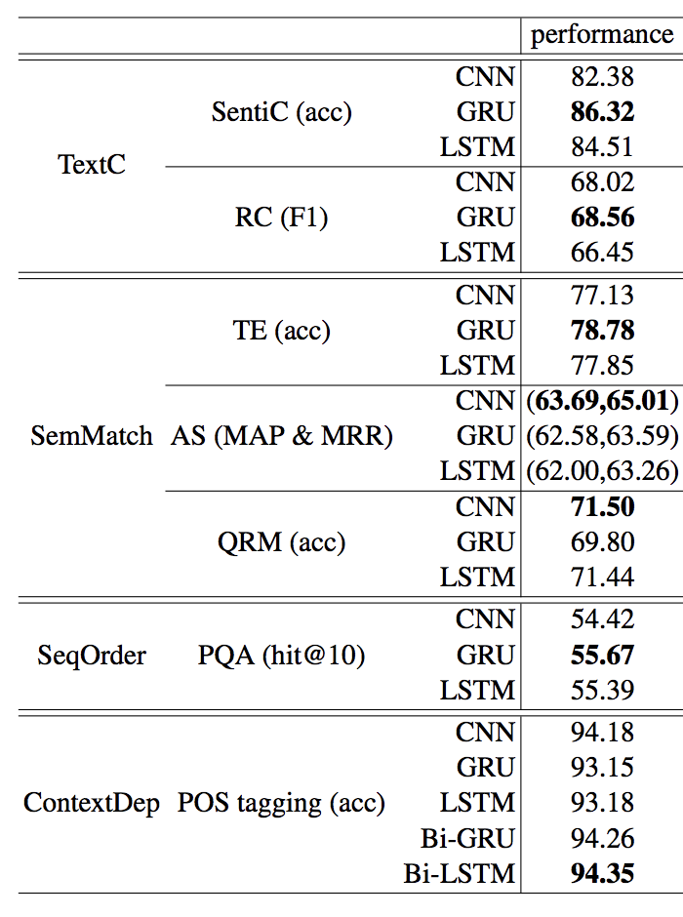
Deep Neural Models in NLP
Convolutional NN → Good performance in classification
Vanilla Recurrent NN → Short memory span
GRU → Improves the training efficiency,
compromising the accuracy
LSTM → Improves the memory span
Bi-LSTM → Analyses the input forward and backward
Comparative Study of CNN and RNN for Natural Language Processing. Wenpeng Yin, Katharina Kann, Mo Yu and Hinrich Schutze. IBM Research USA & CIS, LMU Munich, Germany. Sentiment Classification (SentiC), Relation Classification (RC), Textual Entailment (TE), Answer Selection (AS), Question Relation Match (QRM), Path Query, Answering (PQA), Part-of-Speech Tagging (POS tagging
Notes:
Gated Recurrent Units
two gates 1)reset gate 2)update gate→ Gates are nothing but neural networks, each gate has its own weights and biases(but don’t forget that weights and bias for all nodes in one layer are same).
Update gate
Update gate decides if the cell state should be updated with the candidate state(current activation value)or not.
Reset gate
The reset gate is used to decide whether the previous cell state is important or not. Sometimes the reset gate is not used in simple GRU.
Candidate cell
It is just simply the same as the hidden state(activation) of RNN.
Final cell state
The final cell state is dependent on the update gate. It may or may not be updated with candidate state. Remove some content from last cell state, and write some new cell content.
Now you know about RNN and GRU, so let’s quickly understand how LSTM works in brief. LSTMs are pretty much similar to GRU’s, they are also intended to solve the vanishing gradient problem. Additional to GRU here there are 2 more gates 1)forget gate 2)output gate.
Forget gate
It controls what is kept vs forgotten, from previous cell state. In laymen terms, it will decide how much information from the previous state should be kept and forget remaining.
Output gate
It controls which parts of the cell are output to the hidden state. It will determine what the next hidden state will be.

Slide 12
NLP Evolution – Semantic Meaning
Semantic global meaning – Semantic Web
Unique identifier
Dependency relation with other entities (Triples)
Semantic datasets (Knowledge Base)
Keep the data available (Open liken Data)
Creates graphs dependencies
Enable the machine to machine interaction (Name space declaration)
Limitations
Data standardization
Domain expert
Some datasets might have Low usability
Notes:
Chemical compound, molecule, chemistry, laboratory, DNA, connections, links, ensemble, group, partnership, network; magnification, inspection; three-dimensional; depth; focus

Slide 13
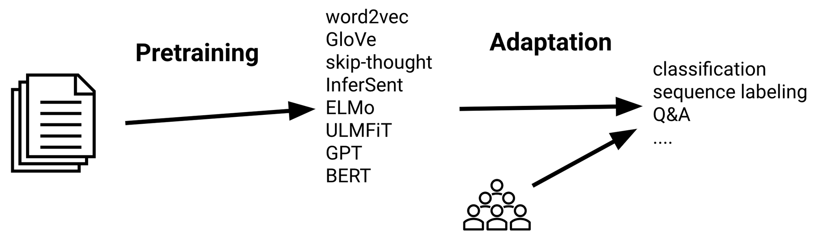
Mainstream NLP – Transfer Learning
https://docs.google.com/presentation/d/1fIhGikFPnb7G5kr58OvYC3GN4io7MznnM0aAgadvJfc/edit#slide=id.g5888218f39_37_30

Slide 14
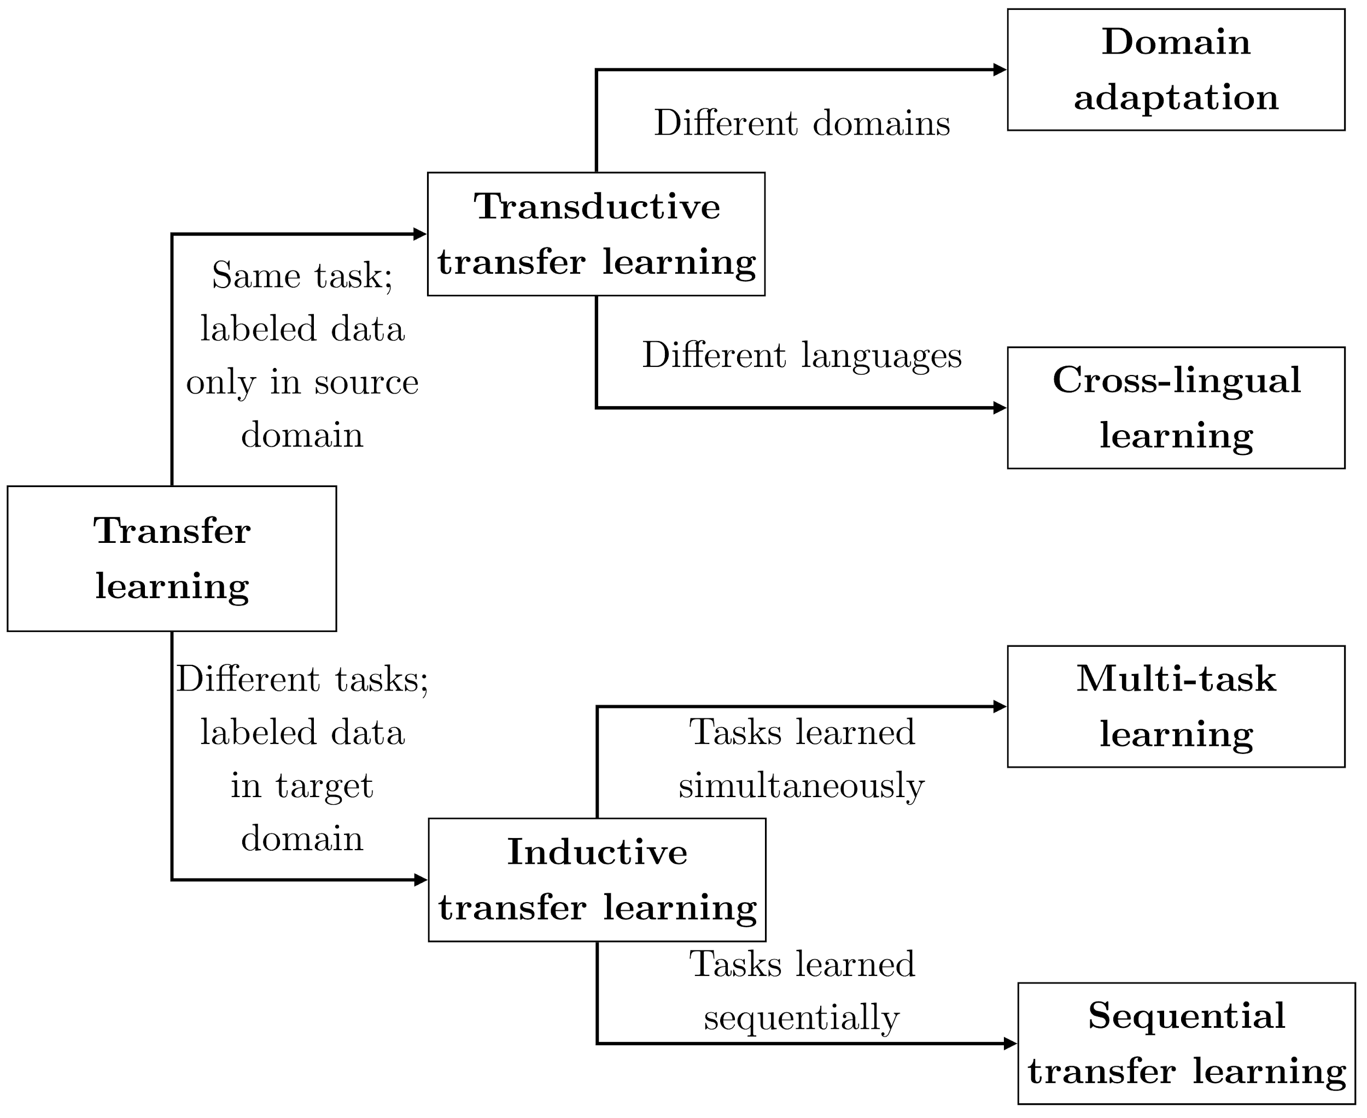
Types of transfer learning in NLP
https://docs.google.com/presentation/d/1fIhGikFPnb7G5kr58OvYC3GN4io7MznnM0aAgadvJfc/edit#slide=id.g5888218f39_37_30

Slide 15
AWS Services

Slide 16







AI Services: Easily add intelligence to application
AI SERVICES
HEALTH AI
INDUSTRIAL AI
ANOMALY DETECTION
CODE AND DEVOPS
NEW
Amazon HealthLake
Amazon Transcribe Medical
Amazon Comprehend Medical
NEW
AWS Panorama + Appliance
NEW
Amazon Monitron
NEW
Amazon Lookout for Equipment
NEW
Amazon Lookout for Vision
NEW
Amazon Lookout for Metrics
NEW
Amazon DevOps Guru
Amazon CodeGuru
 | VISION | SPEECH | TEXT | SEARCH | CHATBOTS | PERSONALIZATION | FORECASTING | FRAUD | CONTACT CENTERS
Amazon Rekognition
Amazon Polly
Amazon Transcribe
+Medical
Amazon Comprehend
+Medical
Amazon Translate
Amazon Textract
Amazon Kendra
Amazon Lex
Amazon Personalize
Amazon Forecast
Contact Lens
Amazon Fraud Detector
Voice ID
For Amazon Connect
store
Amazon S3
trigger
Audio Input
call
in cascade
aggregate
analyze
AWS
Lambda
Amazon
Transcribe
Amazon
Comprehend
Amazon
Athena
Amazon
QuickSight
Notes:
We serve developers and companies who want to add solution-oriented intelligence to their applications through an API call rather than developing and training their own models. And we have a lot of services in this area to address your needs.
Industrial AI services are designed to help our customers in manufacturing, agriculture, energy, or other heavy industries. Amazon HealthLake is specifically made for our health care and life sciences customers.
Vision (Rek Image and video) “tell me what’s in this image,” “which celebrities are in this image,” and, “is this image safe for work?”
Speech – (Polly, Transcribe) – If you want to turn text into speech we have Polly, and if you want to transcribe audio we have Transcribe
Text (translate, comprehend, textract) – If you want to translate text to different languages we have translate, and if you want to understand what’s being said in those translated corpuses of text you have Comprehend, if you want to extract text from documents using OCR++, you have Textract.
Then you have the things which Amazon is relatively famous for. Alexa and chatbots with Lex, personalization, and forecasting
Amazon Kendra is a new service which reinvents enterprise search with machine learning.
Amazon Fraud Detector, a new fraud management service for detecting online identify and payment fraud in real-time. No machine learning experience required.
Amazon CodeGuru, a new machine learning service to automate code reviews and identify your most expensive line of code. Amazon DevOps Guru provides dev/ops engineers an early warning system for operational issues.
Contact Lens for Amazon Connect provides machine learning powered contact center analytics for Amazon Connect.

Slide 17






Amazon SageMaker – Built-in Algorithms
Rethinking algorithms design for large scale & streaming data
Amazon
SageMaker
K-Means XGBoost PCA
Linear Learner Seq2Seq
DeepAR
Factorization Machines
Object Detection
BlazingText
Image Classification
K-Nearest Neighbor
LDA Neural Topic Model
Random Cut Forest
Object2Vec IP Insight
Semantic Segmentation
Data
Algorithms
as-a-service

Slide 18







Amazon SageMaker – Bring-Your-Own-Algorithm
Build your own algorithms, SageMaker handles the rest
Amazon SageMaker Training Service Supported Containers
Data
Custom algorithms

Slide 19
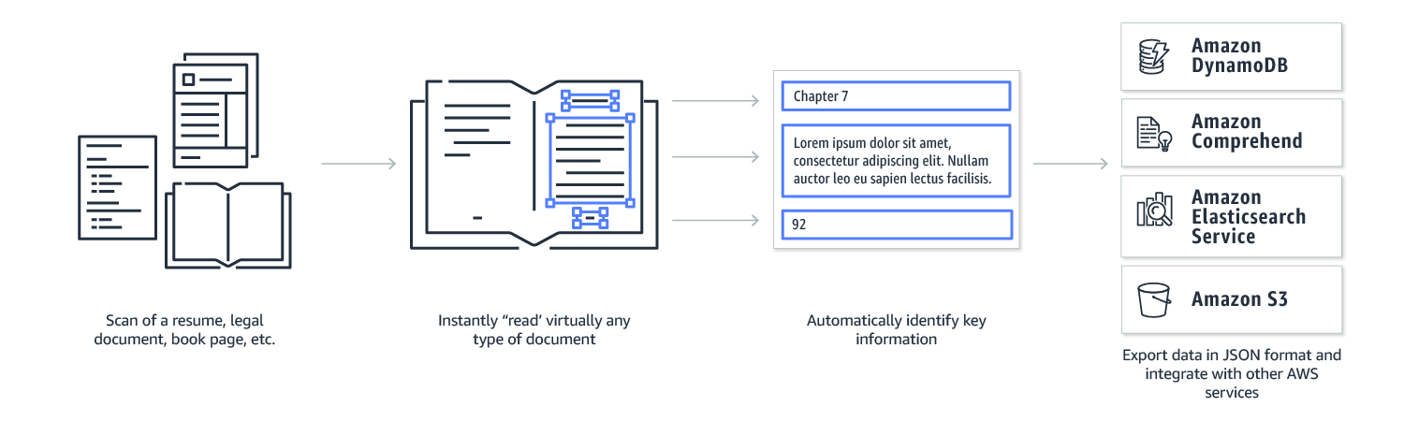
Amazon Textract – OCR++
OCR
Notes:
Amazon Rekognition is a service that applies machine learning to extract information from images and video

Slide 20


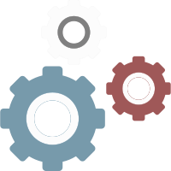

Amazon Polly Turn text into lifelike speech using deep learning
Wide selection of voices and languages
Synchronize speech
Fine-grained control
Unlimited replay
Speech to Text NER POS Tagging

Slide 21






Amazon Transcribe Automatic conversion of speech into accurate, grammatically correct text
Multiple
languages
Intelligent punctuation and formatting
Timestamp generation
Support for
telephony audio
Recognize multiple speakers
Custom vocabulary
NER Tagging Inference Speech To Text

Slide 22



Amazon Comprehend Discover insights and relationships in text using deep learning
Entities
Key Phrases
Amazon Comprehend
Language
Sentiment
NER Text category Sentiment Analysis

Slide 23
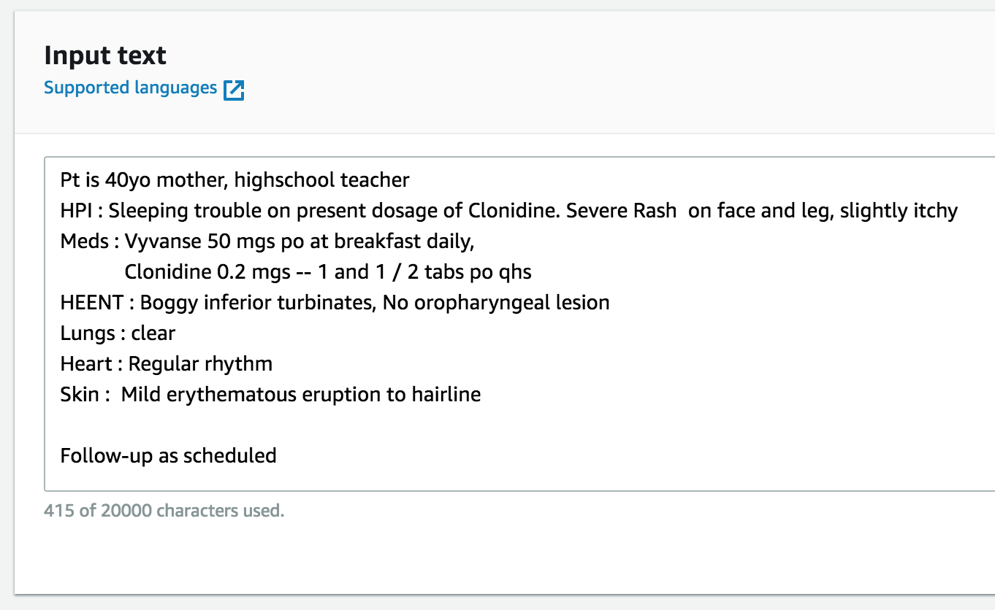
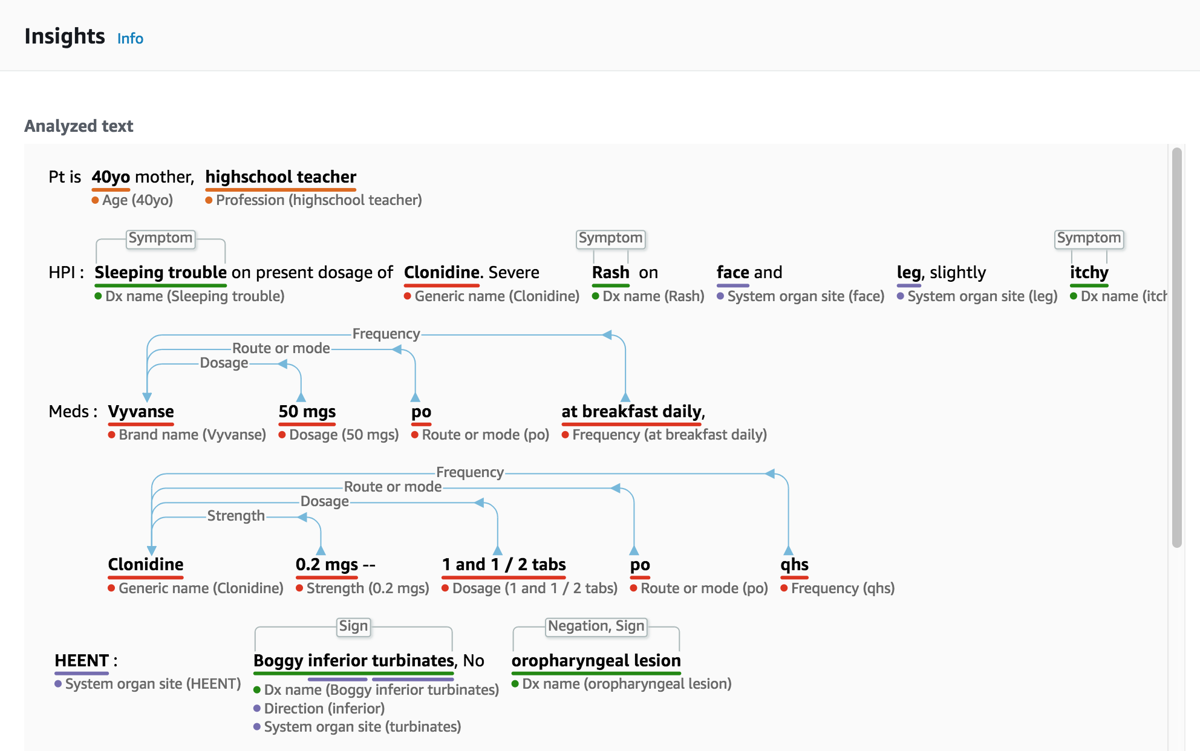
Amazon Comprehend Medical
Extract information from unstructured medical text accurately and quickly
No machine learning experience required
NER Text category Sentiment Analysis
Notes:
Can identify complex medical stuff
Can identify PHI and allow you to remove it from data

Slide 24

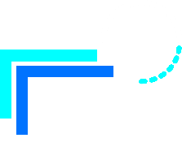


Amazon Translate Natural and fluent language translation
Real-time translation
Batch analysis
Automatic language
recognition
Low cost
NER Text category Sentiment Analysis

Slide 25
Amazon Kendra Quickly and easily finding accurate information
EASY TO FIND WHAT YOU ARE LOOKING FOR
SIMPLE AND QUICK TO SET UP
Natural language Queries
NLU and Machine Learning core
Domain Expertise
Continuous Improvement
Native connectors
Simple API and console experiences
Code samples
NLU Inference NER Text category
QA Text category
Notes:
Amazon Kendra reinvents search with deep learning Intelligent models that enable both keyword and natural language queries to extract answers (a word, phrase or passage) and find documents with pinpoint accuracy.
Kendra addresses the three most critical needs of enterprise search today:
easy to implement
higher accuracy
continuously improving

Slide 26

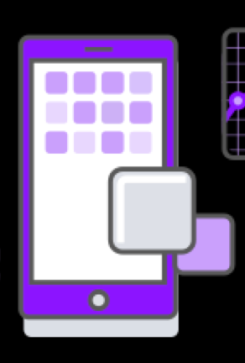



Amazon Lex – Features
Text and speech language understanding: powered by the same technology as Amazon Alexa
Deployment to chat services
Designed for builders: efficient and intuitive tools to build conversations; scales automatically
Enterprise SaaS connectors: connect to enterprise systems
Versioning and alias support
@
Inference NER Speech Tagging Text category Dialog agents NLU QA Sentiment Analysis

Slide 27
Contact Lens for Amazon Connect Better insights lead to better customer service
Transcribes live
and archived calls
Enhanced search
on call and chat
transcripts,
sentiment scores,
silence duration etc.
Custom categorization
to Identify common
call types
Prioritized
list of recurring
issues based on
customer feedback
Real time
dashboard and
alerting for supervisors
Provide agents with answers to questions as they are being asked
Inference NER Speech Tagging Text category
Dialog agents Summarization QA Sentiment Analysis
Notes:
Lastly, we introduced Contact Lens for Amazon Connect, a fully-managed add-on that allows customers of Amazon Connect, our cloud contact center service
Use the power of ML without requiring any technical skills to do things such as identify common call types, identify recurring themes based on customer call feedback, alert supervisors when customers are having a poor experience, and assist agents with a knowledge base to answer questions as they are being asked.

